Slide 1
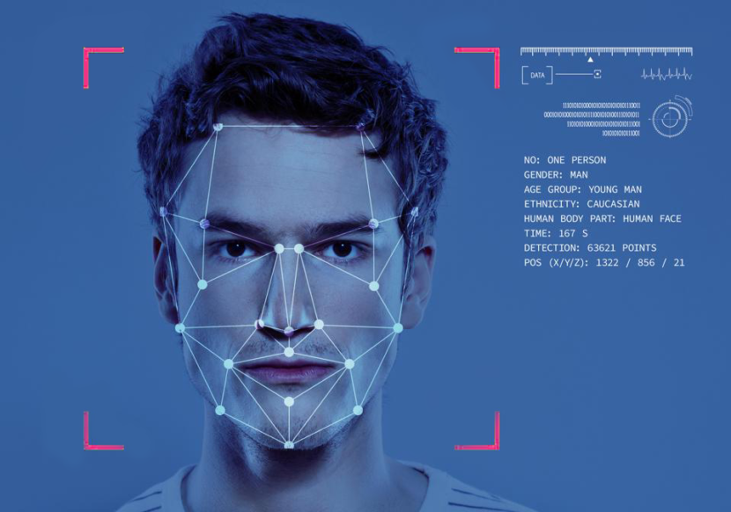

“FACE RECOGNITION ATTENDANCE SYSTEM“
SUBMITTED BY :
1826246 Vatane Sanket Namdev
1826250 Ansari Amaan Arif
1826243 Sonawane Shubham Deepak
1926504 Shinde Pratik Pandit

Slide 2
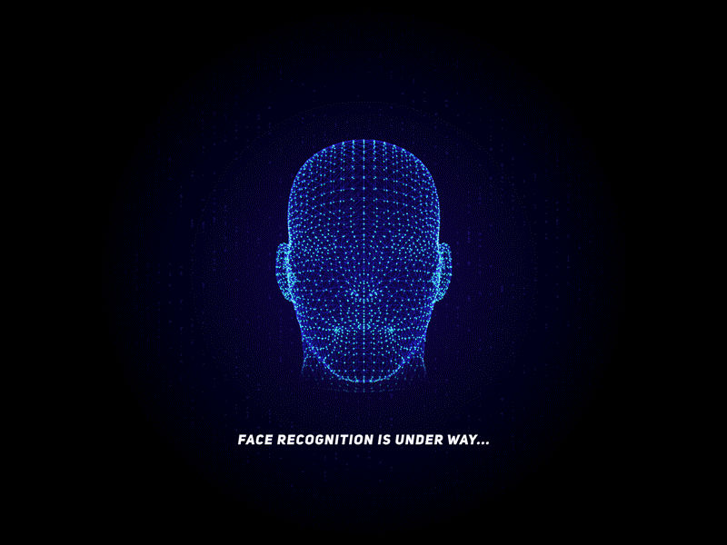
Introduction
The purpose of this project is to build a face recognition-based Attendance system for educational institutions to enhance and upgrade the current System into more efficient and effective as compared to before. The human face is one of the natural traits that can uniquely identify an individual. Therefore, it is used to trace identity as the possibilities for a face for being duplicated is low.

Slide 3


Statement of Problems
Proxy attendance
Managing attendance
Old method of taking attendance
is time consuming.

Slide 4



Requirements
Python 3.9.5
VSCode
Microsoft Visual C++ 2014 Build tools
requirements.txt :
It contains a list of all the modules required for running our system , you can install all the modules by typing the following command in your terminal :
pip install –r requirements.txt

Slide 5
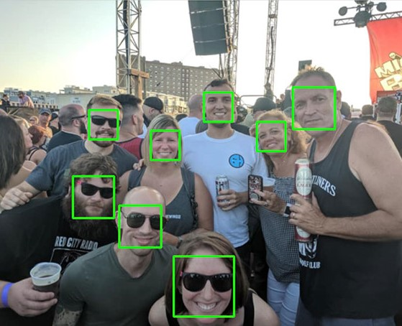
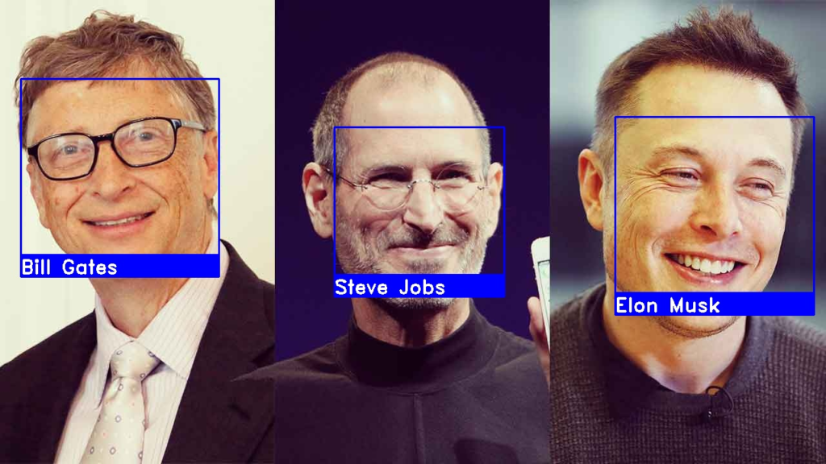
What is Face Detection ?
Face detection is a technique that identifies or locates human faces in digital images or videos .It detects presence of faces in an image .
Face detection is performed using classifiers . A classifier is essentially an algorithm that decides whether a given image is positive(with a face) or negative(without a face).
What is Face Recognition ?
Face recognition is different from face detection .It focuses on identifying whose face it is rather than detecting a face in an image .
It is a category of biometric software that maps an individual’s facial features mathematically and stores the data as a faceprint. The software uses Deep Learning algorithms to compare a live capture or digital image to the stored faceprint in order to verify an individual’s identity.

Slide 6

OpenCV
Open CV (Open Source Computer Vision Library) is an open source computer vision and machine learning library. This was built to give a common structure for computer vision applications and to influence the use of machine interpretation in the commercial products like facial recognition which is extensively use in today’s world. Open CV has more than 2,500 optimized algorithms. These algorithm can be used to detect and identify faces, objects, track moving objects in a video or in an image, follow eye movements etc.
Open CV has been written in C++ and has templated interface that work with STL containers (Standard Template Library: it is a set of C++ template classes to provide common programming data structure and functions like list, array, stack etc). Open CV has C++, Python, Java and Matlab interfaces and supports Windows, Linux, Mac OS and also Android

Slide 7
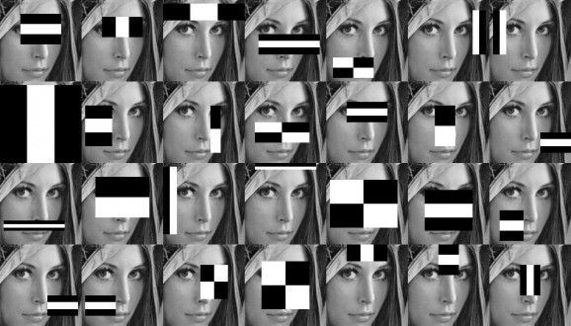
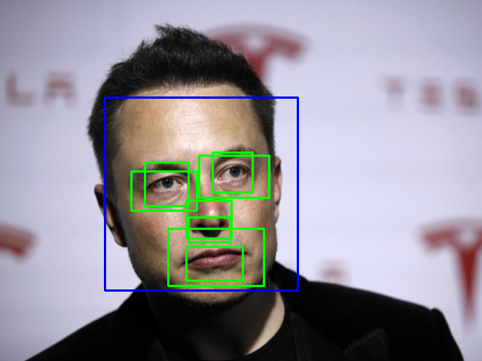
Haar Cascade
A Haar Cascade is a classifier which is used to detect the object for which it has been trained for. The Haar cascade is trained by superimposing the positive image over a set of images. This type of training is generally done on a server and on various stages. Better results are obtained by using high quality images and increasing the amount of stages for which the classifier is trained for. This cascade makes it easier to build a model. One just needs to pre-define the Haar cascade which are available on github. Moreover one can make their own cascade file.

Slide 8
Facial Recognition using Python Libraries
The most popular and probably the simplest way to detect faces using Python is by using the OpenCV package. Originally written in C/C++, OpenCV now provides bindings for Python.
It uses machine learning algorithms to search for faces within a picture. Faces are very complicated, made of thousands of small patterns and features that must be matched. The face recognition algorithms break the task of identifying the face into thousands of smaller, bite-sized tasks, each of which is easy to solve, known as classifiers.
The OpenCV cascade breaks the problem of detecting faces into multiple stages. It performs a detailed test for each block. The algorithm may have 30 to 50 of these stages or cascades, and it will only detect a face if all stages pass.
The cascades are a bunch of XML files that contain OpenCV data used to detect objects. You initialize your code with the cascade you want, and then it does the work for you. Since face detection is such a common case, OpenCV comes with a number of built-in cascades for detecting everything from faces to eyes to hands to legs.

Slide 9
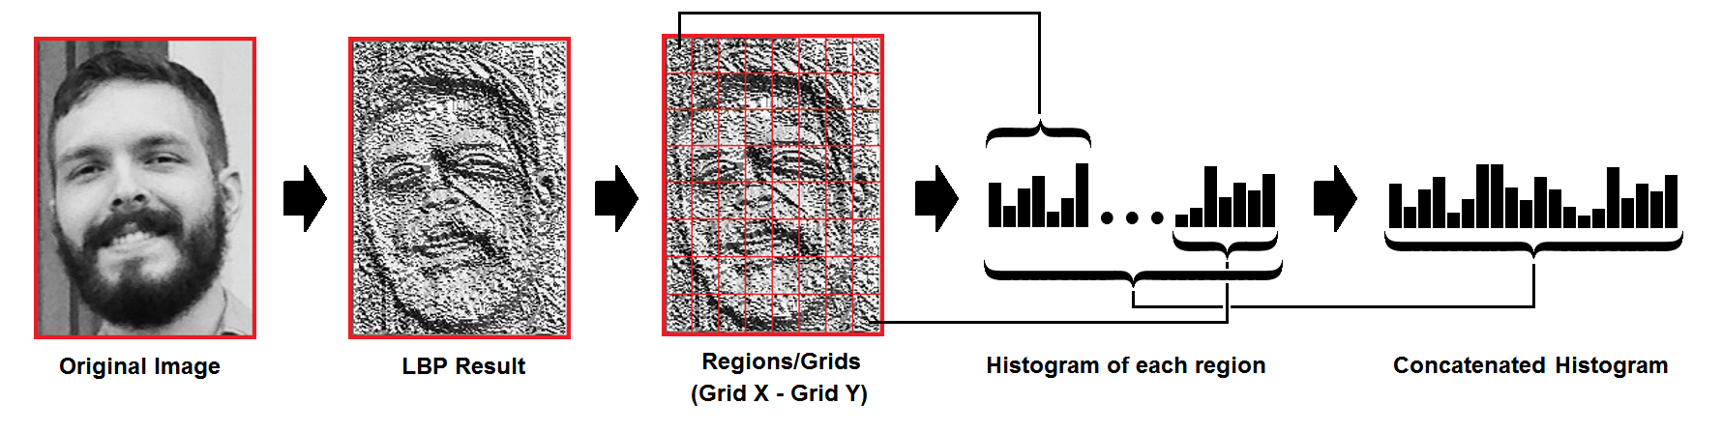
LBPH Algorihtm
Local binary patterns (LBP) is a type of visual descriptor used for classification in computer vision. LBP is the particular case of the Texture Spectrum model proposed in 1990. It has been found to be a powerful feature for texture classification; it has further been determined that when LBP is combined with the Histogram of oriented gradients (HOG) descriptor, it improves the detection performance considerably on some datasets.
The LBP feature vector, in its simplest form, is created in the following manner:
Divide the examined window into cells .
For each pixel in a cell, compare the pixel to each of its 8 neighbors (on its left-top, left-middle, left-bottom, right-top, etc.). Follow the pixels along a circle, i.e. clockwise or counter-clockwise.
Where the center pixel's value is greater than the neighbor's value, write "0". Otherwise, write "1". This gives an 8-digit binary number (which is usually converted to decimal for convenience).
Compute the histogram, over the cell, of the frequency of each "number" occurring (i.e., each combination of which pixels are smaller and which are greater than the center). This histogram can be seen as a 256-dimensional feature vector.
Optionally normalize the histogram.
Concatenate (normalized) histograms of all cells. This gives a feature vector for the entire window.

Slide 10
Working :
First Part: (Data Collection) :
The first and the major part is to collect samples of data on which this model needs to be trained.
Defining Path :
detector = cv2.CascadeClassifier("haarcascade_frontalface_default.xml“)
The cascade file will help your model classify your facial expression and will help in recognizing the face for which it has been trained
Face Extraction :
gray = cv2.cvtColor(img, cv2.COLOR_BGR2GRAY)
In this we basically convert the color of the captured images to gray because, color information doesn’t help us in identify important edges or other features .
Multi Scaling :
faces = detector.detectMultiScale(gray, 1.3, 5)
After the color transition we use detectMultiScale(), this basically detects objects of different sizes in the input image and the detected objects are returned as list of rectangle. This method has three main parameters which involves image, scale factor and nearest neighbors.

Slide 11
Cropping Image :
gray[y:y + h, x:x + w]
This is the very crucial part as in this we just crop the image so that we could get the face of the object.
Reading :
isTrue, img = cam.read()
Now after cropping the face we start reading. The read() function returns two values one Boolean and second the coordinates .
Resizing and saving the Output :
cv2.imwrite("TrainingImage\ " + name + "." + str(serial) + "." + Id + '.' + str(sampleNum) + ".jpg", gray[y:y + h, x:x + w])
Then we resize the cropped image into the desired set of frames, also declaring the location of the file where the training data is going to be saved .
Wait Key :
cv2.waitKey(100) & 0xFF == ord('q')
This is a method which is used to kill the process if ‘q’ pressed, it only takes ASCII values .
Releasing and Destroying the windows :
cv2.destroyAllWindows()
This method is used to destroy all the windows which are opened during the process of capturing the data .

Slide 12
Second Part (Training and Predicting the Data)
Training :
In this part we will train the model on the data that we have collected and based on the training our model will predict , whether the user is the same user or its somebody else .
The model which determines the face of the subject is defined which is :
recognizer=cv2.face.LBPHFaceRecognizer_create()
Therefore we use this as our primary model for training the sample data. Then we train our data using
recognizer.train(faces, np.array(ID))
Predicting :
In this we use test our model and based on our model will determine and predict whether the user is the same for which the data has been trained or not. Few steps of this part are similar to the steps listed in part one. Then we set a threshold value, if our model predicts and the prediction value comes out to be less than the threshold value then it means that the face has been recognized by the recognizer .
conf = recognizer.predict(gray[y:y + h, x:x + w])

Slide 13
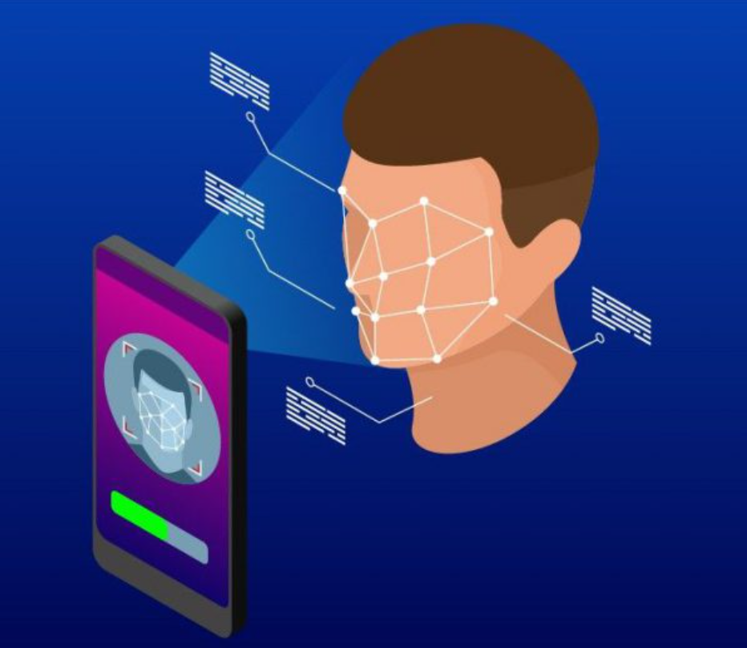

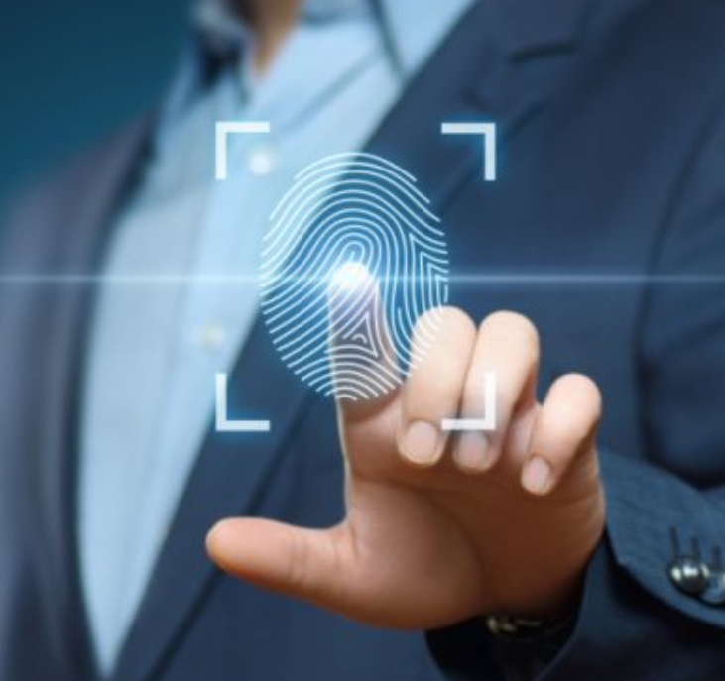
Why is Face recognition better than FingerPrint ?
Facial recognition works better for a person as compared to fingerprint detection. It releases the person from the hassle of moving their thumb or index finger to a particular place rather the user just have to place his/her face in front of cam and within seconds the result is calculated . So they provide a better user experience .
Even tech giant Apple.inc also removed fingerPrint scanner from iphones when the lauched the iphone X for better user experirnce.
It is very effective in current scenario of pandemic as compare to fingerPrint system where we have of touch the fingeprint reader .

Slide 14




Advantages
Automated time tracking system
Cost-effective
Convenient and User friendly
Avoid proxy attendance
Time saving
Easy to Manage

Slide 15
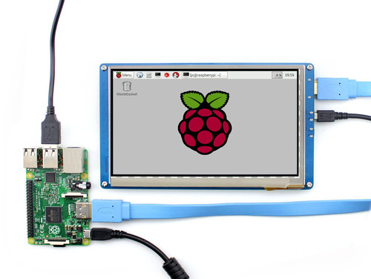

Future scope
Creating Online databases so that the college can directly access the records of attendance and can easily calculate the percentage of attendance .
Adding facility of sending Emails and SMS to absent students and their Parents or guardians so that the parents or guardians are aware of what their kids are doing.
Using raspberry pi and camera to create a compact face recognition attendance system that can be installed on walls or doors for offices , schools and colleges.

Slide 16

Conclusion
Our face recognition system detects the faces in a picture taken by web-cam, and these face images are then recognized by the system .
Python is really a powerful programming language for face detection and recognition
It was a wonderful experience for our team working on this project , we learned a lot of new concepts and strategies , that made us a better engineer.

Slide 17
References
Pyhton documentation : https://docs.python.org/3/
Open Cv Documentation : https://docs.opencv.org/master/
Code with Harry Python for Beginners : https://www.youtube.com/watch?v=gfDE2a7MKjA
Freecodecamp.org Opencv tutotial : https://www.youtube.com/watch?v=oXlwWbU8l2o
https://www.javatpoint.com/face-recognition-and-face-detection-using-opencv

Slide 18
Print(“THANKYOU !”)
Finally Our Team would like to thank Prof .Shankar Nikam for their kind help and valuable suggestions.

